Slide 1
CHAPTER 3
METABOLIC CHANGES OF DRUGS AND RELATED ORGANIC COMPOUNDS

Slide 2
Objectives
Overview
http://www.google.com.ph/images?hl=tl&biw=1366&bih=607&gbv=2&tbs=isch:1&sa=1&q=metabolites&aq=f&aqi=&aql=&oq=&gs_rfai=
To understand why certain drugs are contraindicated with other drugs
To describe the various phases of drug metabolism
To identify the site of biotransformation of drugs

Slide 3
Objectives
Overview
To recognize the role of specific enzyme
To be acquainted with the metabolism on specific functional groups
To become aware of the metabolism of the currently used therapeutic agents

Slide 4
Metabolism
Overview
Elimination of drugs and other foreign compounds
Prodrugs – active drug
Xenobiotics – foreign compound
two categories:
Catabolism breaks down organic matter
Anabolism uses energy to build up or construct
components of cells such as proteins and
nucleic acids.

Slide 5
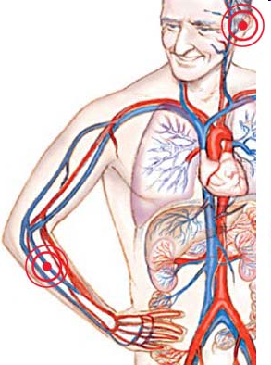
Metabolism
Overview
Important Points to Remember
Most drugs entering the body are lipophilic
Drug molecules easily diffuse through the lipophilic membranes of the GIT

Slide 6
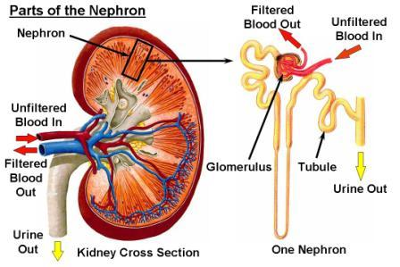
Metabolism
Overview
Important Points to Remember
Some of the Prodrugs or Xenobiotics are NOT completely excreted in the urine due to the reabsorption in the renal tubules

Slide 7
Product of Metabolism
Overview
The product of metabolism must become hydrophilic or converted to a water-soluble substance for elimination
ELIMINATION
COMPLETE
INCOMPLETE
Forms inactive and non-toxic substance
Unwanted biological effect

Slide 8
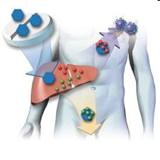
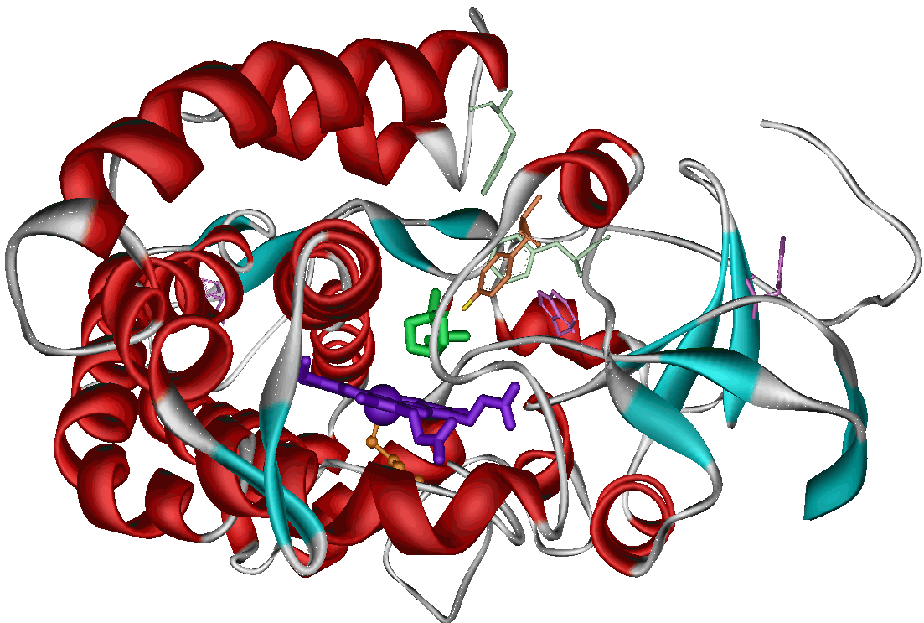
Product of Metabolism
Overview
Xenobiotics
Must be converted to a water-soluble substance (hydrophilic)
Prodrugs/Metabolites
Are mostly lipophilic or lipid-soluble compounds
Metabolism
Is also called DETOXIFICATION or DETOXICATION

Slide 9
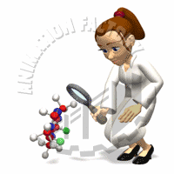
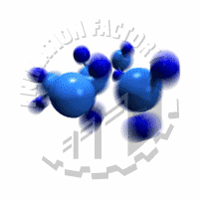
Introduction of Functional Polar Groups to Xenobiotics
General Pathway of Drug Metabolism
Functional Group
Xenobiotic
Direct introduction

Slide 10
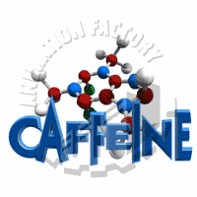
Introduction of Functional Polar Groups to Xenobiotics
General Pathway of Drug Metabolism
Original compound
Modified compound
modification

Slide 11
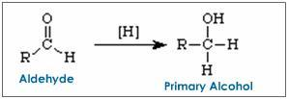
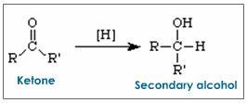
Introduction of Functional Polar Groups to Xenobiotics
General Pathway of Drug Metabolism
Reduction of Ketones & Aldehydes to Alcohol
Unmasking existing functionality
of the

Slide 12
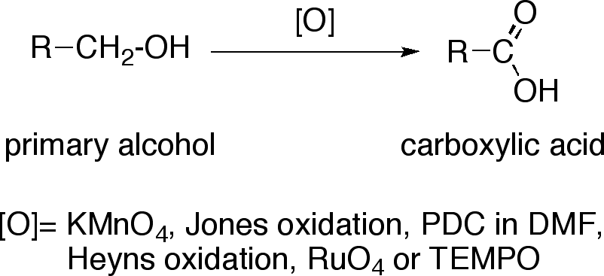
Introduction of Functional Polar Groups to Xenobiotics
General Pathway of Drug Metabolism
Oxidation of Alcohol to Acid
of the
Unmasking existing functionality

Slide 13
Introduction of Functional Polar Groups to Xenobiotics
General Pathway of Drug Metabolism
Hydrolysis of Ester & Amide to Acid
of the
Unmasking existing functionality

Slide 14
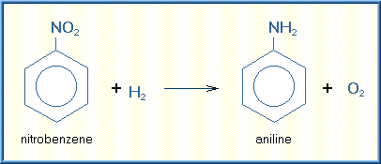
Introduction of Functional Polar Groups to Xenobiotics
General Pathway of Drug Metabolism
Reduction of Nitro compounds to form NH₂ moiety
of the
Unmasking existing functionality

Slide 15
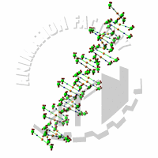
PHASE 1 REACTION
General Pathway of Drug Metabolism
Oxidation Reaction
Do not produce suficiently hydrophilic or inactive metabolites
Provide a functional group or handle
on the molecule that can undergo
Phase 2 reactions

Slide 16
PHASE 2 REACTION
General Pathway of Drug Metabolism
Conjugation Reaction
Terminate ot attenuate biological activity
Methylation
Acetylation
Attach small, polar and ionizable endogenous compounds such as:
Glucoronic acid
Sulfate
Glycine
Other amino acids
Protects the body against chemically reactive compounds or metabolites
Glutathione (GSH) conjugation
Glycine
Other amino acids

Slide 17
PHASE 1 & PHASE 2 REACTION
General Pathway of Drug Metabolism
Oxidation & Conjugation Reaction
Phase 1 & Phase 2 reactions complement one another in detoxifying & facilitating the elimination of drugs & Xenobiotics
CH₃
CH₂OH
Allylic Hydroxylation of Marijuana (Δ¹ tetra Hydrocannabinol)

Slide 18
PHASE 1 & PHASE 2 REACTION
General Pathway of Drug Metabolism
Oxidation & Conjugation Reaction
H
H-C-H
(CH₃)
H
H-C-OH
(CH₂OH)
More polar
Allylic Hydroxylation of Marijuana (Δ¹ tetra Hydrocannabinol)

Slide 19
PHASE 1 & PHASE 2 REACTION
General Pathway of Drug Metabolism
Oxidation & Conjugation Reaction
CH₂OH
COOH
oxidation
CH₃
CH₃
CH₃
CH₃
11- Hydroxy Δ⁹ tetra Hydrocannabinol
Δ⁹ TH Cannabinoic Acid

Slide 20
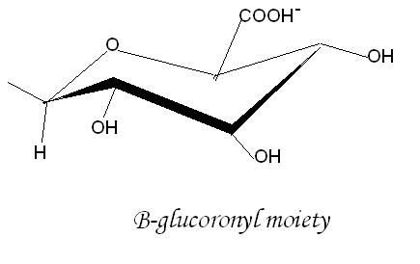
PHASE 1 & PHASE 2 REACTION
General Pathway of Drug Metabolism
Oxidation & Conjugation Reaction
COOR
OR
CH₃
CH₃
Δ⁹ TH 11-Cannabinoic Acid
Subsequent conjugatinon with Glucoronic acid
Glucuronide Conjugate at either the COOH group or the Phenolic OH Group

Slide 21
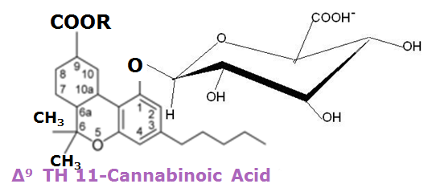
PHASE 1 & PHASE 2 REACTION
General Pathway of Drug Metabolism
Oxidation & Conjugation Reaction
Water-soluble compound
eliminated completely in the urine
Subsequent conjugatinon with Glucoronic acid
Glucuronide Conjugate at either the COOH group or the Phenolic OH Group

Slide 22
General Pathway of Drug Metabolism
The Biotransformation Pathway
PHASE I or FUNCTIONALIZATION REACTIONS
A. Oxidative Reaction B. Reductive Reactions
-Oxidation of Aromatic Moieties - Reduction of aldehydes and ketones
Oxidation of Olefins - Reduction of Nitro and Azo compounds
Oxidation of Benzyclic, Allylic carbon atoms, carbon - Miscellaneous Reductive reactions
atoms ∂ Carbon atoms to carbonyl and imines
Oxidation of Aliphatic and Alicyclic carbon atoms C. Hydrolytic Reactions
Oxidation of Carbon-heteroatom systems: - Hydrolysis of Esters and Amides
* Caron-Nitrogen system - Hydration of Epoxides and arene oxide by
* Carbon – Sulfur system epoxide hydrase
* Caron – Oxygen system
Carbon – Alcohols and Aldehydes
Other miscellaneous oxidative reactions
PHASE II or CONJUGSTION REACTIONS
A. Glucuronic Acid Conjugation
B. Sulfate Conjugation
C. Conjugation with Glycine, Glutamine and other Amino Acids
D. Glutathione or Mercapturic Acid Conjugation
E. Acetylation
D. Methylation

Slide 23
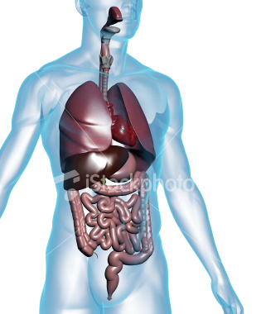
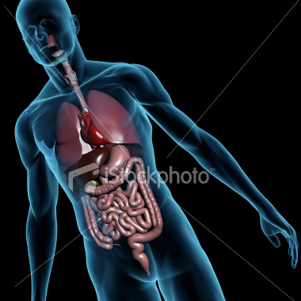
SITES DRUG BIOTRANSFORMATION
General Pathway of Drug Metabolism
of
LIVER
The most important organ in drug metabolism
Contains almost all drug metabolizing enzyme
INTESTINAL MUCOSA
Contains CYP3A4 isoenzyme and
P-glycoprotein

Slide 24
SITES DRUG BIOTRANSFORMATION
General Pathway of Drug Metabolism
of
Absorption site of oral drugs
to
bloodstream
pass
through
liver
into
distributed
Body compartments
undergo
HEPATIC METABOLISM
First-Pass Effect
HEPATIC METABOLISM

Slide 25
SITES DRUG BIOTRANSFORMATION
General Pathway of Drug Metabolism
of
HEPATIC METABOLISM
List of DRUGS
undergo
First-pass effect
Isoproterenol
Morphine
Propoxyphene
Lidocaine
Nitroglycerine
Propranolol
Meperidine
Pentazocaine
Salicylamide

Slide 26
…to be continued next meeting. Please prepare ½ crosswise for a short quiz…
Good Luck!

